Slide 1
Schedule-free autonomous boats in Bergen
A reinforcement-learning approach to real-time fleet dispatch
NHH . Supervisors: J. C. Goez, S. W. Wallace

Slide 2
Introduction and motivation
Bergen is a coastal city fragmented by fjords. Land transport is congested and expensive to expand.
Small autonomous boats could connect points that are close by water but far by road, with no drivers and no fixed timetable.
We study the real-time operation of such a service over four points: Kleppesto, Laksevag, Bryggen and Sandviken.
Passengers state where and when they want to arrive. The system decides, moment by moment, how the boats move.
The question of the thesis: can a learned policy operate this system well, close to the best possible service.
2

Slide 3
Related work and the gap we fill
Gu and Wallace (2021), autonomous water taxis in Bergen: a static model for terminal location, fleet and routing.
Braathen, Goez and Guajardo (2024), autonomous ferries under labour rules: a static weekly plan with pre-built routes.
Sanchez-Martinez et al. (2017): schedule-free high-frequency transit, the operating idea behind this work.
All of these are static and solved with full demand known in advance.
Our contribution: the real-time operation under demand uncertainty, learned rather than pre-computed. This is the dynamic piece the group's static models did not cover.
3

Slide 4
What was built, in sequence
1. Navigable routing
real over-water travel times (water mask and Dijkstra)
2. Demand model
synthetic demand anchored in open SSB data (gravity model)
3. Environment (MDP)
a discrete-time simulator, 2-minute steps
4. Reference policy
a coordinated greedy heuristic (the baseline)
5. Learning agent
a PPO agent trained in the simulator
6. Comparison
agent against baseline on real service metrics
4

Slide 5
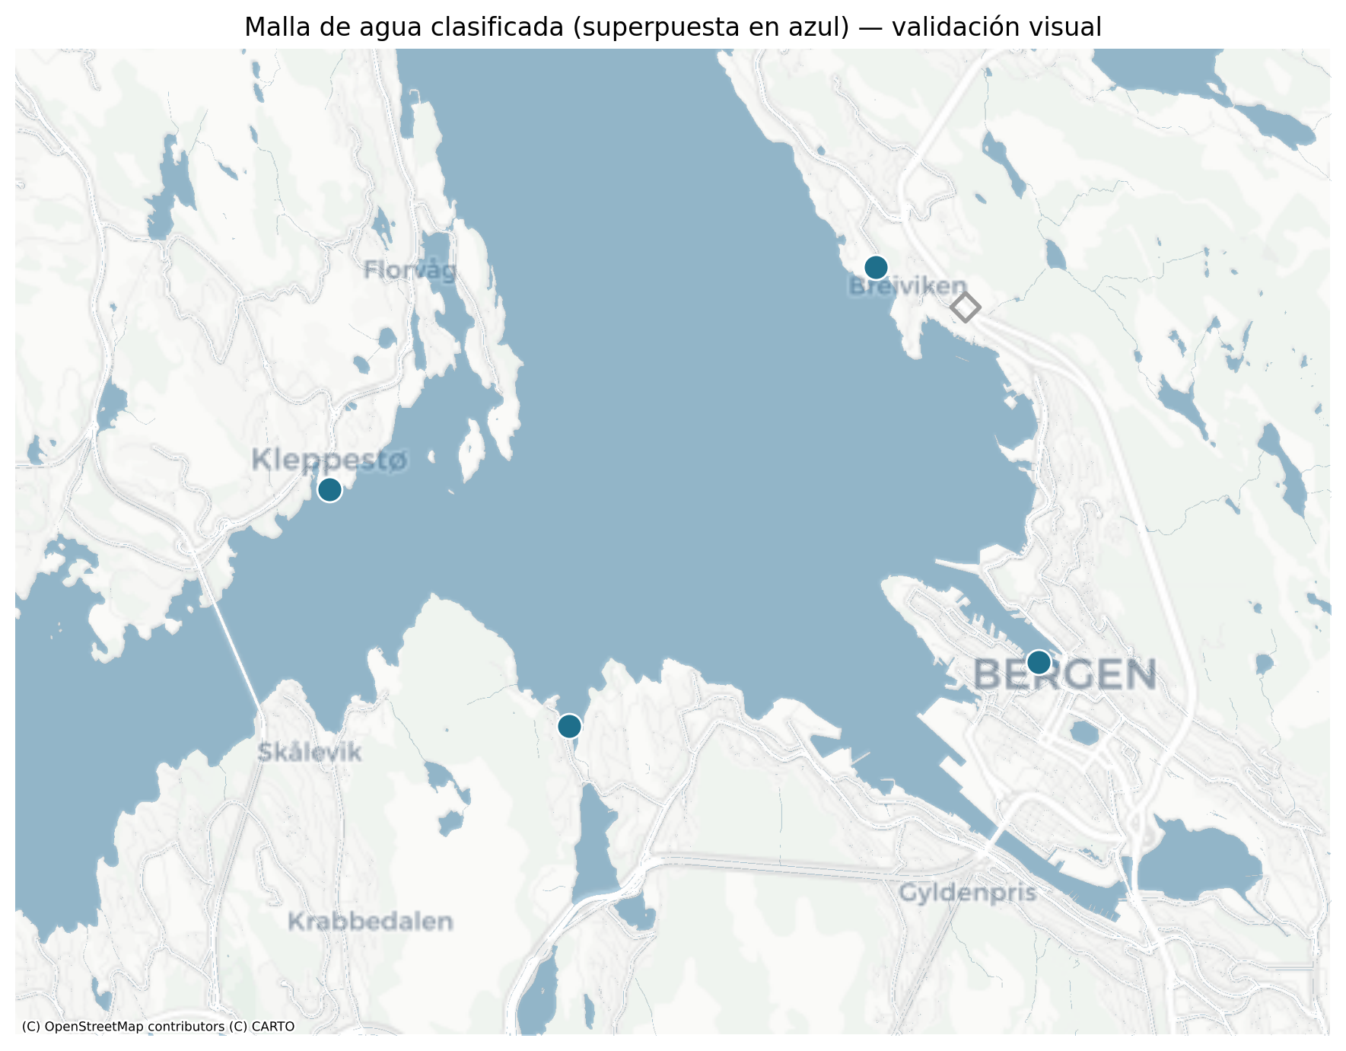
Navigable routing (1): method
Straight lines between points cross land. A boat has to go around the coast.
A water and land mask is built from map tiles, classifying each pixel.
Every water pixel becomes a node, connected only to neighbouring water pixels.
Dijkstra finds the shortest path that never crosses land.
Water and land mask over Bergen
5

Slide 6
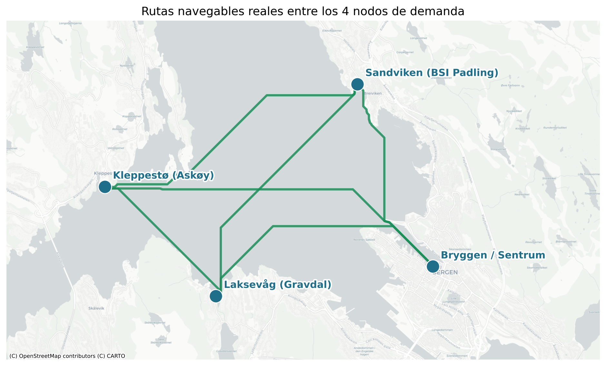
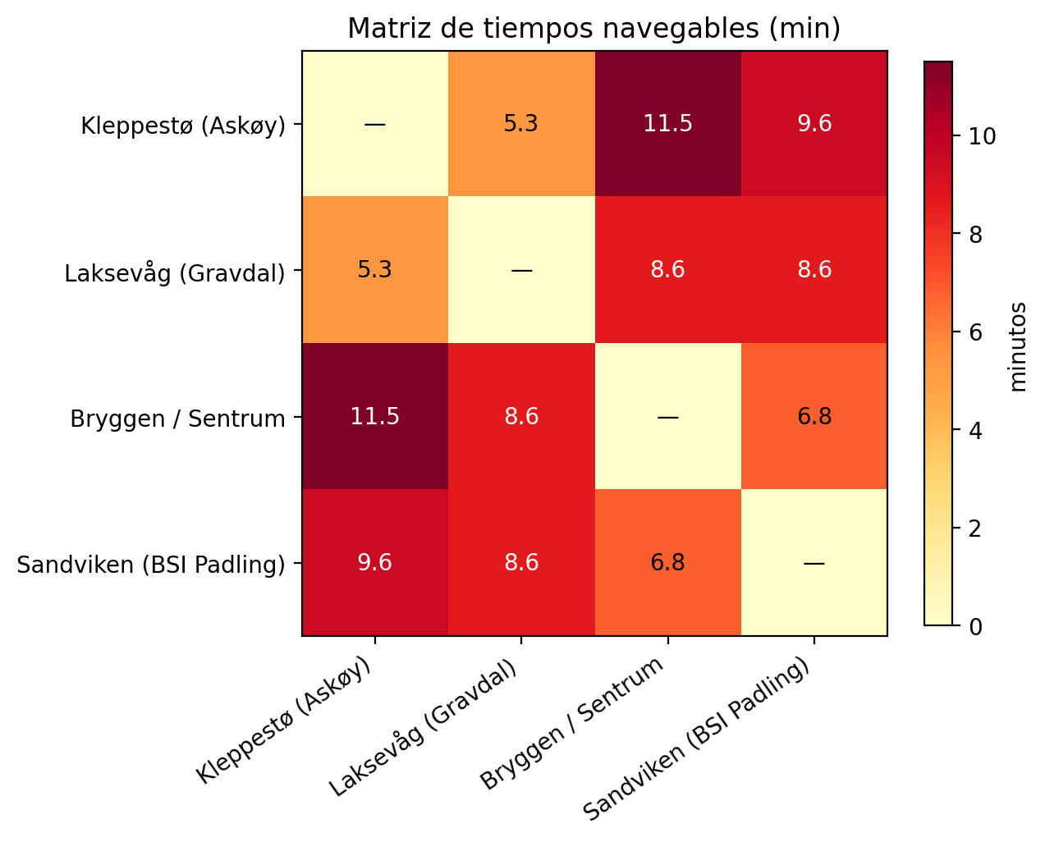
Navigable routing (2): result and calibration
Speed set to a design value of 30 km per hour.
Kleppesto to Bryggen is about 11.5 minutes, close to the real 14-minute ferry crossing, which calibrates the model.
The result is a travel-time matrix used everywhere downstream.
Navigable routes between the four points
Travel-time matrix (minutes)
6

Slide 7
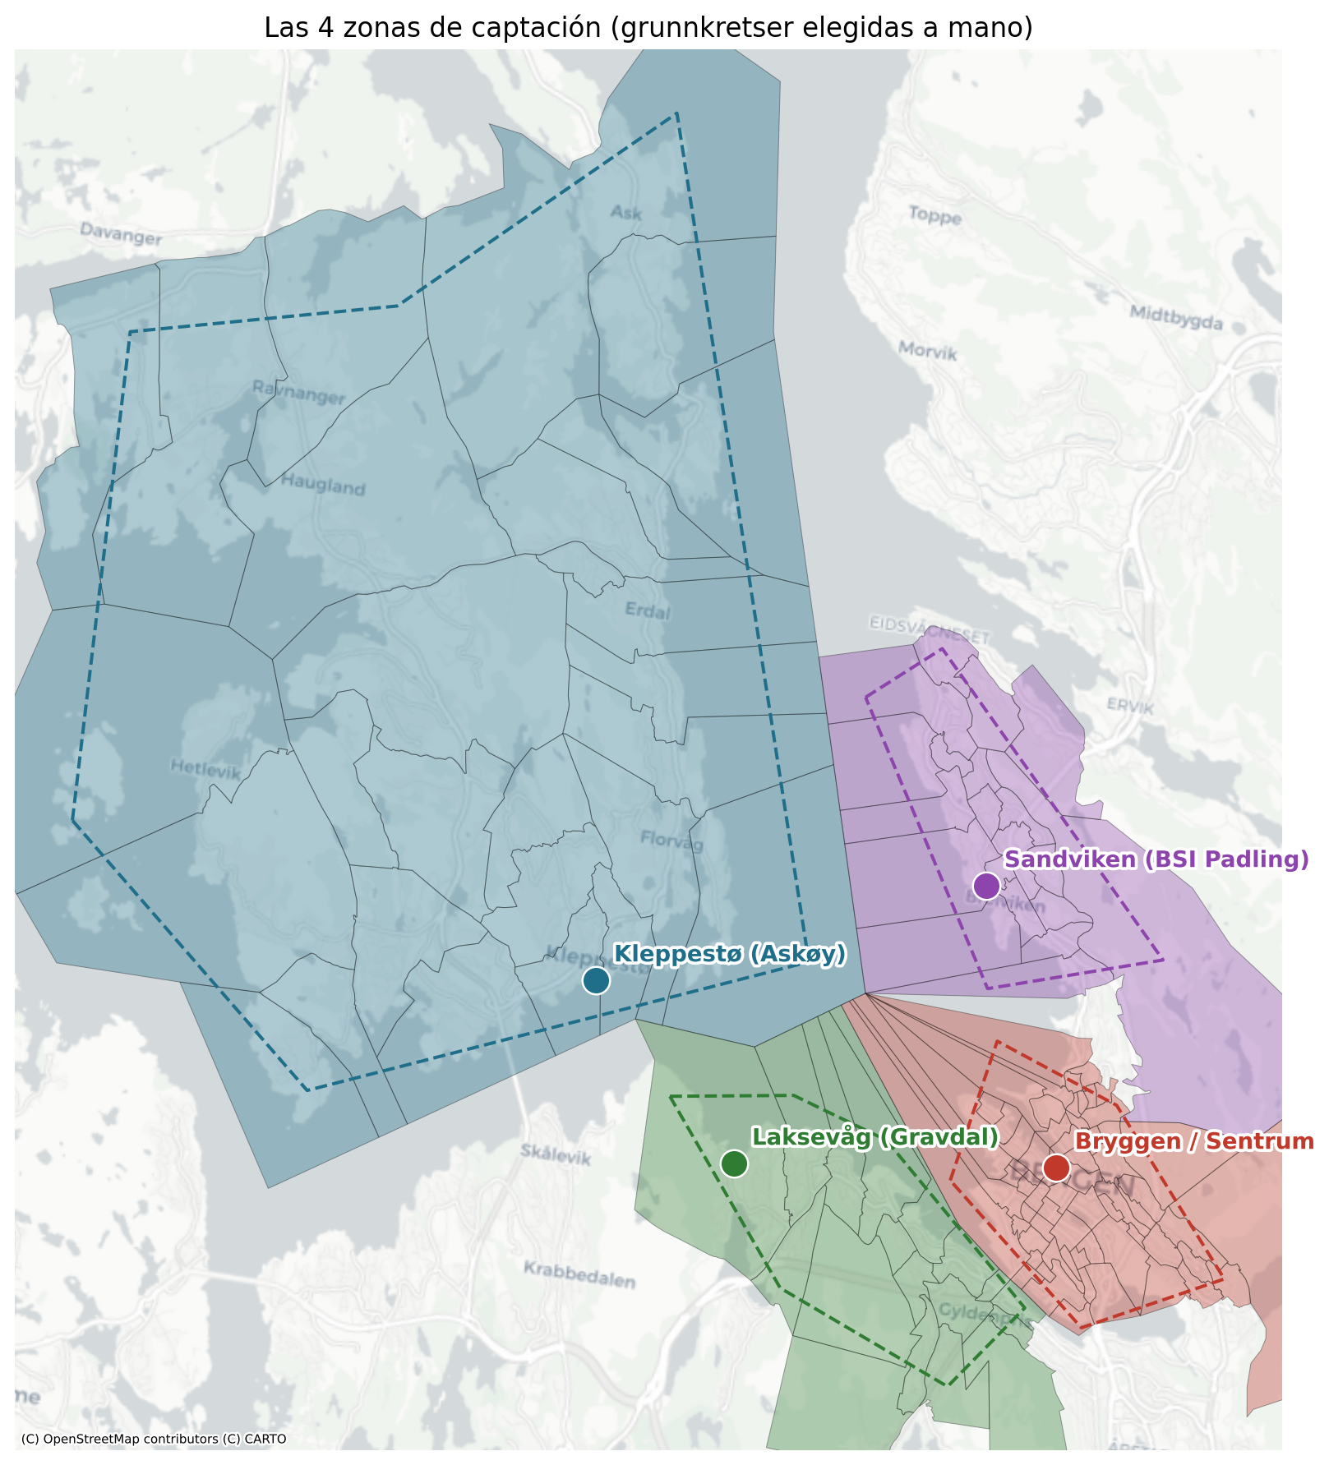
Demand model (1): catchment areas and masses
No real demand exists, so it is generated, but anchored in open data.
Around each point we take the real statistical zones it serves.
From Statistics Norway (SSB) we read residents per zone (origin mass) and jobs per zone (destination mass).
These real masses replace the hand-picked scores used in earlier work.
Catchment zones per point (SSB grunnkretser)
7

Slide 8
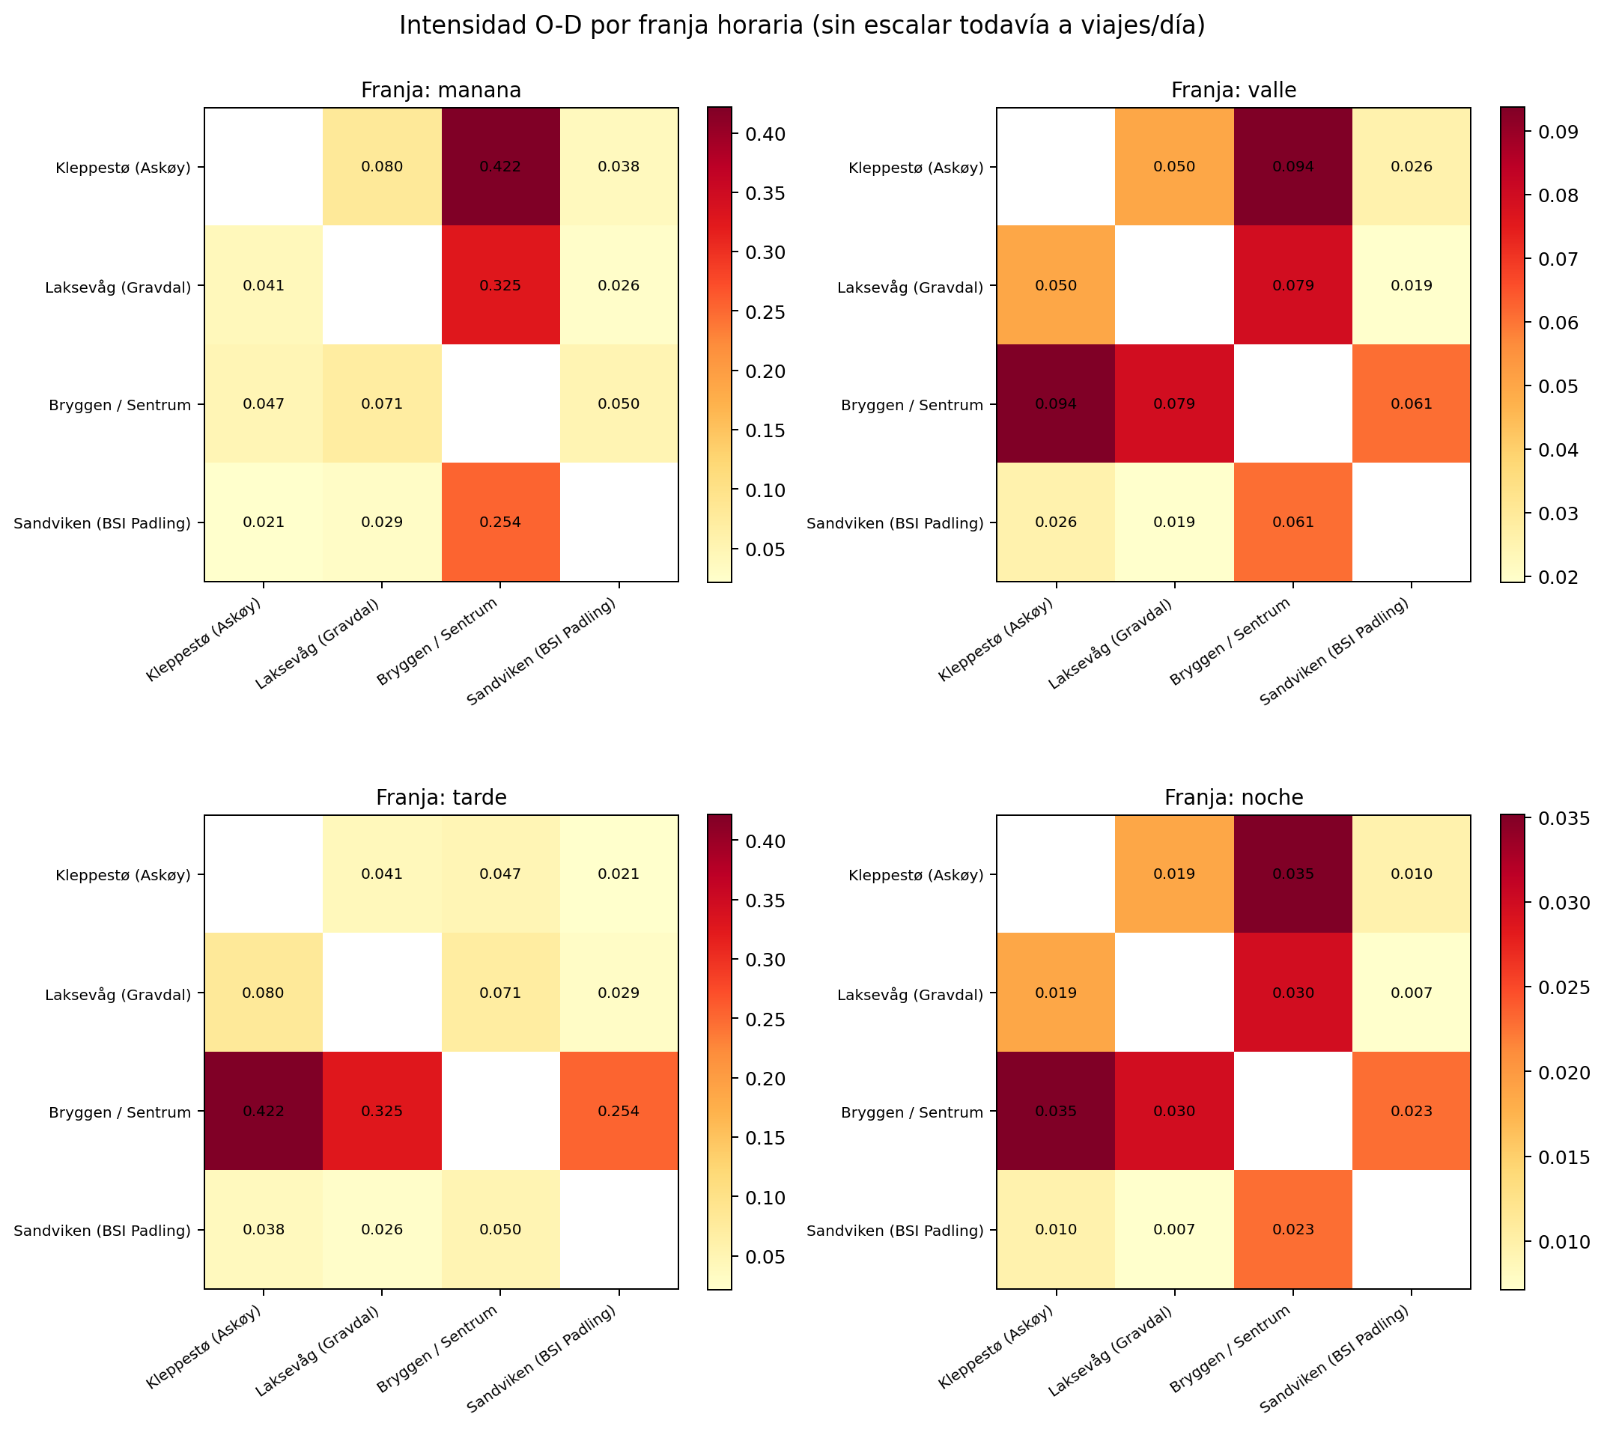
Demand model (2): gravity model
Relative flow between two points:
flow(i, j) = mass_origin(i) x mass_dest(j) x exp( - travel_time(i,j) / tau )
Masses come from SSB (residents and jobs).
The friction term uses the real navigable travel time.
Roles switch by time band: mornings weight residents at the origin (home to work), afternoons weight jobs (work to home).
The 90 to 10 morning split toward the centre was not imposed, it emerges from the data (it came out near 83 to 17).
Origin-destination intensity by time band
8

Slide 9
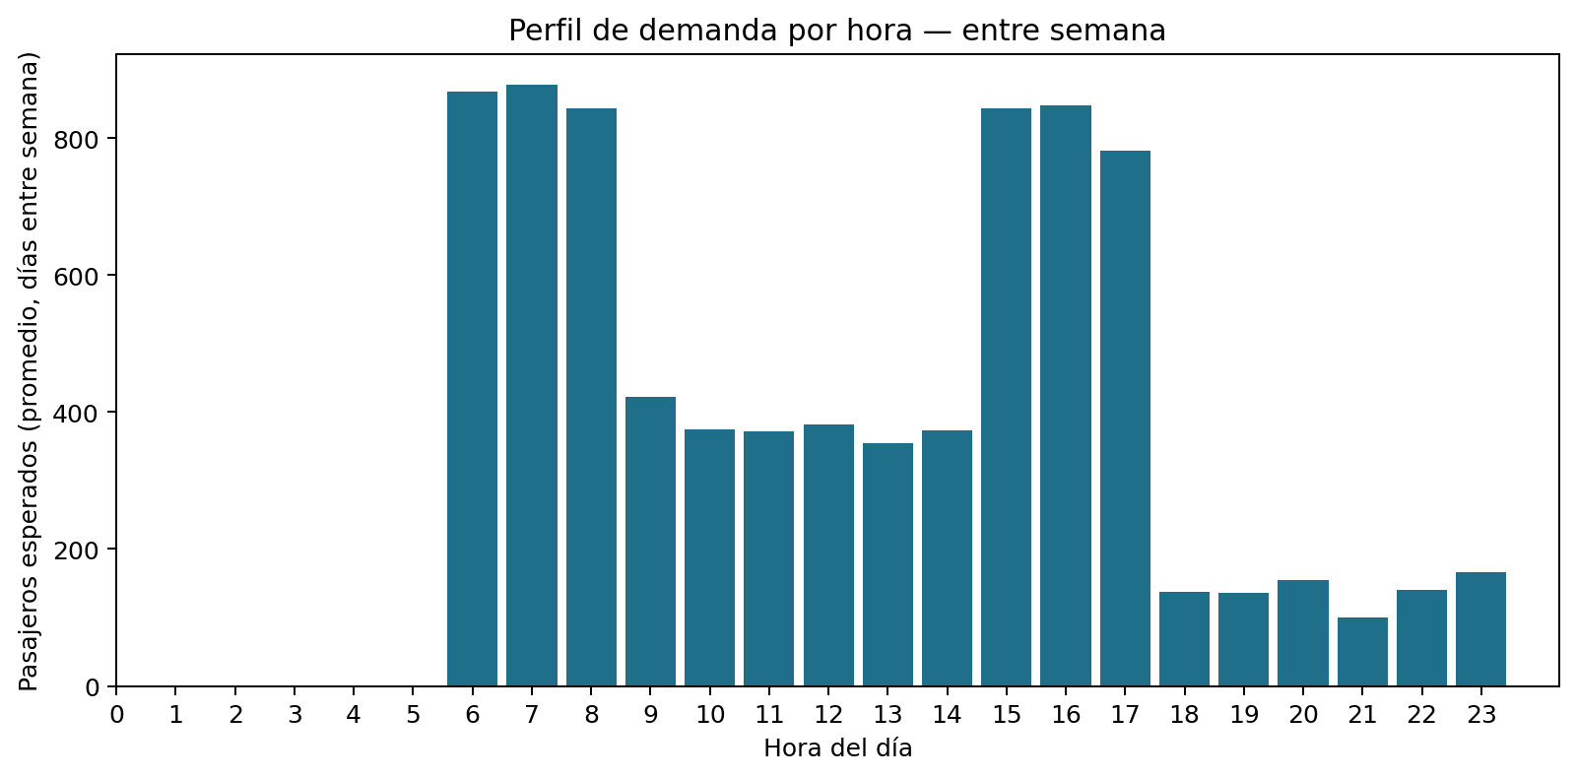
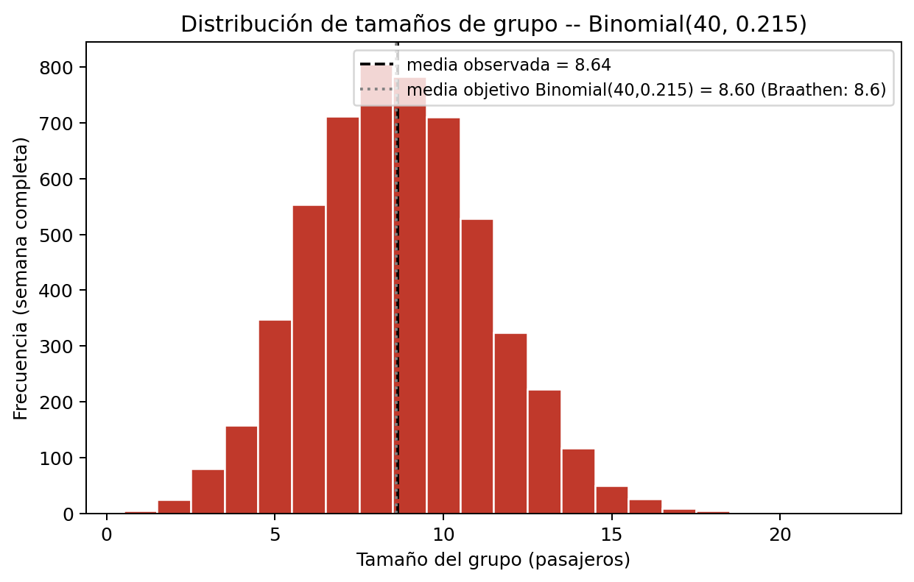
Demand model (3): arrivals and group sizes
The daily volume is anchored to the national travel survey, about 3.26 trips per person per day, times a small water-capture fraction.
Arrivals over the day follow a Poisson process whose rate rises and falls with the time band.
Passengers arrive in groups, mean size about 8.6, matching Braathen et al.
Demand profile by hour (morning and afternoon peaks)
Group-size distribution
9

Slide 10
Simulation environment: the MDP
State
boat positions and occupancy, passengers waiting per pair, time of day
Action
for each boat, go to one of the four points, or wait (no mid-route change)
Transition
the simulator, boats move on real times, demand arrives, 2-minute steps
Reward
penalises time in the system and inefficient movement (next slide)
Discount
gamma = 0.99, high, so the agent looks ahead and avoids the tail effect
The simulator is the environment. It is deterministic once the demand realisation is fixed.
10

Slide 11
Reward, derived from the objective (Little's law)
True objective (minimise):
J = sum_i T_i + lambda . sum movements
Identity: total time in system equals the area under the count of passengers present.
sum_i T_i = integral N(t) dt approx sum_t N_t . dt
So penalising the passengers present each step is minimising total time in system.
r_t = - ( sum_active s_i . dt + lambda . boats_moving ) gives sum_t r_t = - J
The reward is the incremental form of the objective, not a hand-tuned guess (Little 1961, Ng et al. 1999).
11

Slide 12
Reference dispatch policy (the baseline)
A fixed greedy rule, no learning: when a boat is free, send it to serve the passengers who have waited longest and that it can still reach in time.
Boats are coordinated. They are assigned one at a time, and each assignment is subtracted from the queues before the next boat decides, so two boats do not chase the same passengers.
This is not a weak baseline. It is a competent coordinated heuristic, which makes it a demanding target for the agent.
It is written as an interchangeable function, so the agent can replace it without touching the simulator.
12

Slide 13
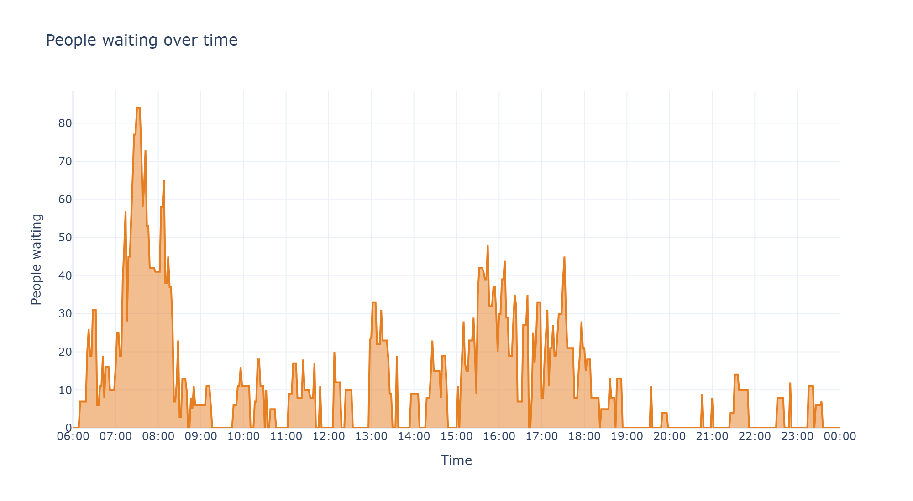
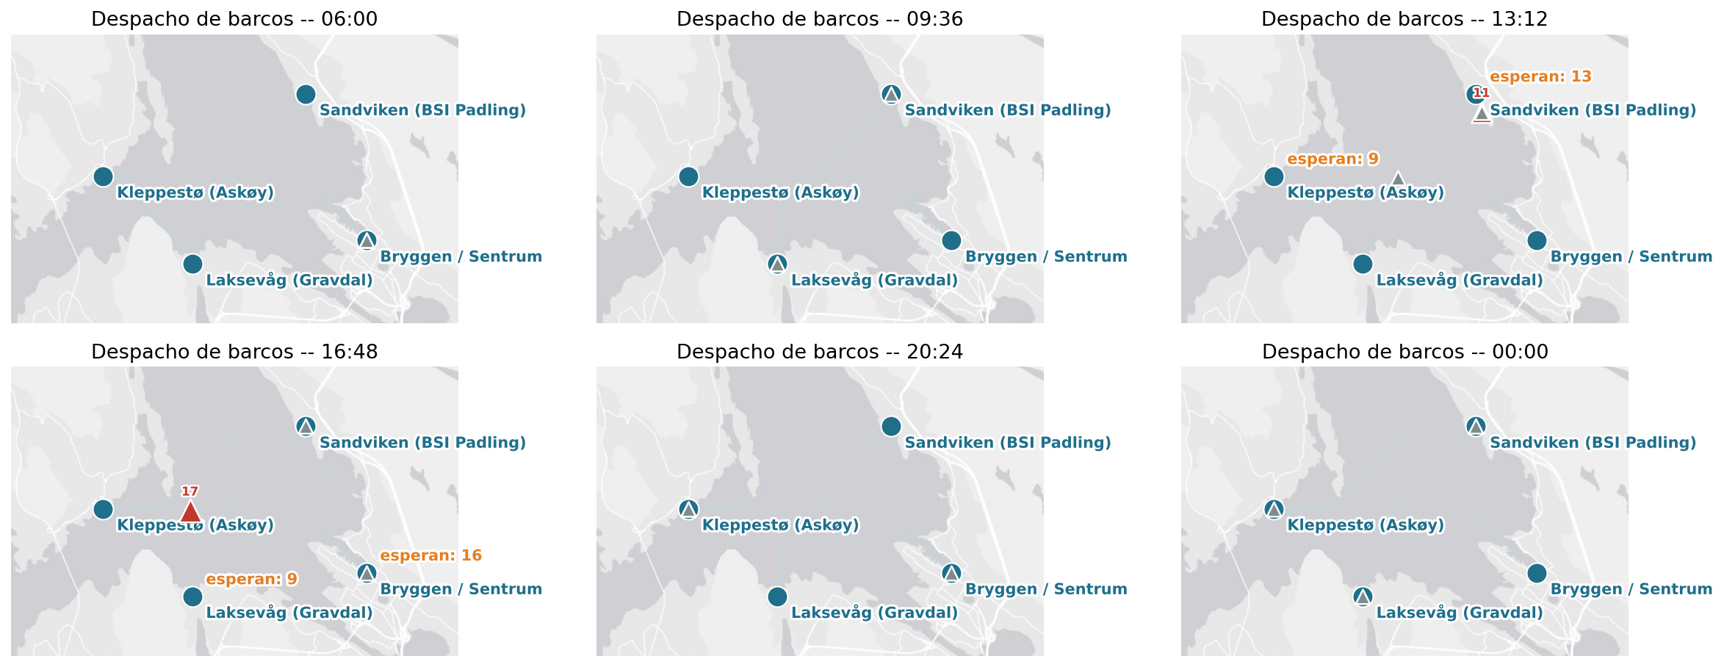
Reference policy: verification at three scales
Verified on morning, full day and full week, checking that every passenger ends accounted for (served, or still waiting at the end).
Full detailed metrics per pair, per boat and per user.
Waiting profile over the day
Snapshots of the fleet in operation
13

Slide 14
Learning agent: PPO
The action is one choice per boat (a MultiDiscrete space). DQN cannot handle this, so we use PPO.
PPO is an actor-critic method. A policy network chooses actions, a value network estimates how good a state is.
Proximal means each update changes the policy only a little, which keeps training stable.
Both DQN and PPO use neural networks. The difference is what the network learns, values or the policy itself.
The reward and the discount define the objective. Bellman's relation drives the value updates inside PPO.
14

Slide 15
Agent: observation, action and hyperparameters
Observation, a fixed-length vector: one block per boat, demand aggregated per origin-destination pair, and the time of day.
Node identities are one-hot, and all quantities are normalised so the network learns well.
Action, one destination per boat, or wait.
Hyperparameter | Value
Algorithm | PPO (Stable-Baselines3)
Discount gamma | 0.99
Learning rate | 0.0003
Entropy coef. | 0.01
Update horizon n_steps | 512
Normalisation | VecNormalize (obs and reward)
Training steps | 150,000
Train / eval seeds | 123 / 1001-1005
15

Slide 16
Reward-shaping experiments (short runs to choose the design)
Variant | Setting | Attended % | Max time (min)
A | time penalty, with ceiling | 47.8 | 118.1
B | time penalty, no ceiling | 51.9 | 88.4
C1 | B + movement 0.003 | 52.0 | 139.9
C2 | B + movement 0.001 | 44.7 | 69.0
Short exploration runs of 30,000 steps, only to pick the reward design (not the final agent).
Removing the ceiling (B) beats A, the agent feels the urgency to serve the longest-waiting first.
A small movement weight (about 0.003) keeps the fleet moving without paralysis. The final agent uses no ceiling with a small movement weight.
16

Slide 17
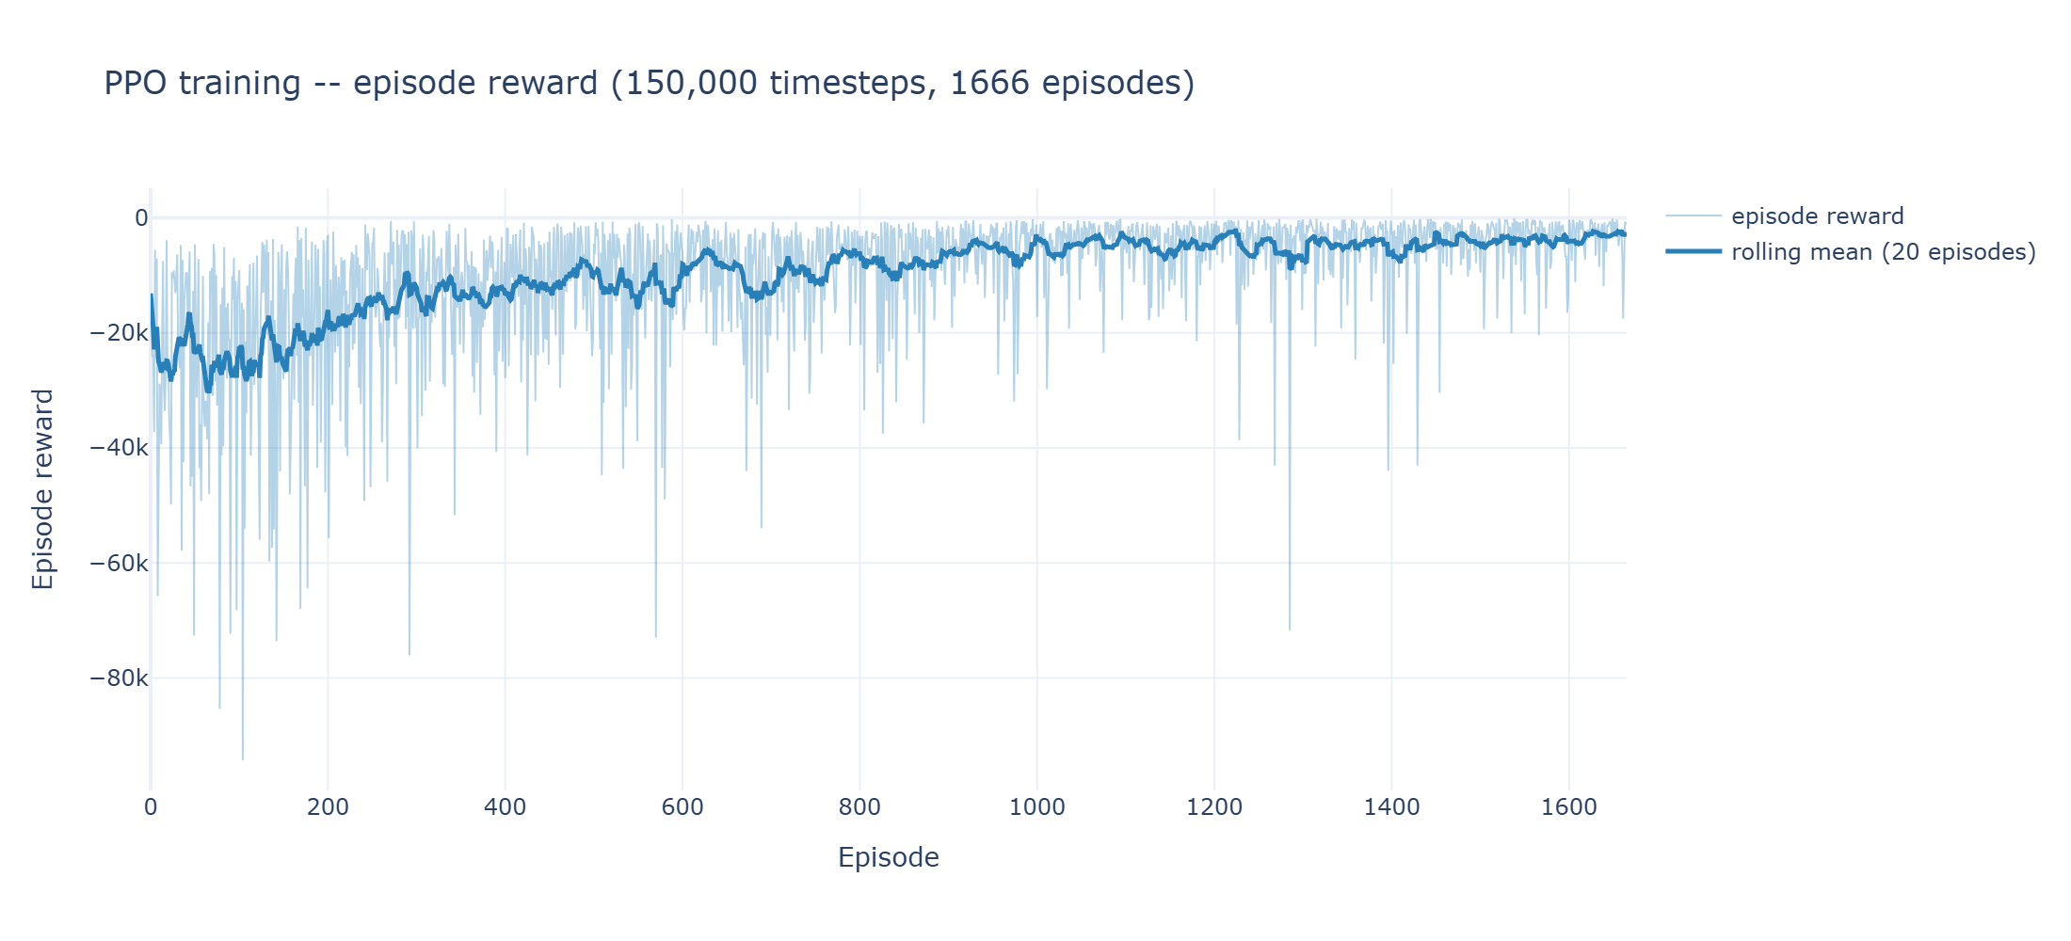
Agent: training run and fresh demand
Each training episode draws a fresh demand realisation, so the agent sees many different weeks and learns to generalise, not memorise. This is a Monte-Carlo view over demand.
Evaluation uses held-out seeds the agent never trained on.
Training curve (reward per episode)
17

Slide 18
Comparison: agent against baseline (five seeds)
Parity on demand served, 88 against 88.
Slightly higher mean time (29 against 26).
Lower worst case (60.8 against 69.7).
Better total reward (-3772 against -5259).
The agent reaches a strong coordinated heuristic and improves the worst case.
18

Slide 19
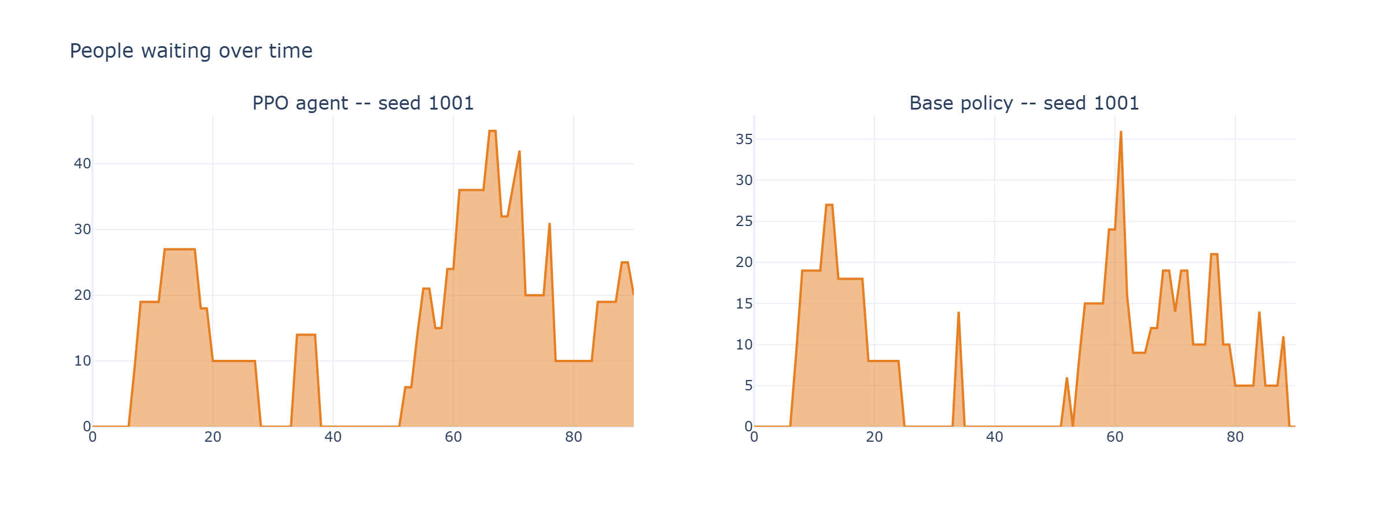
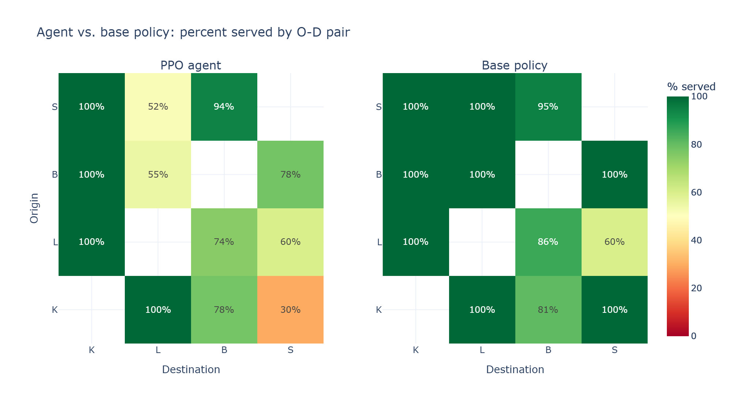
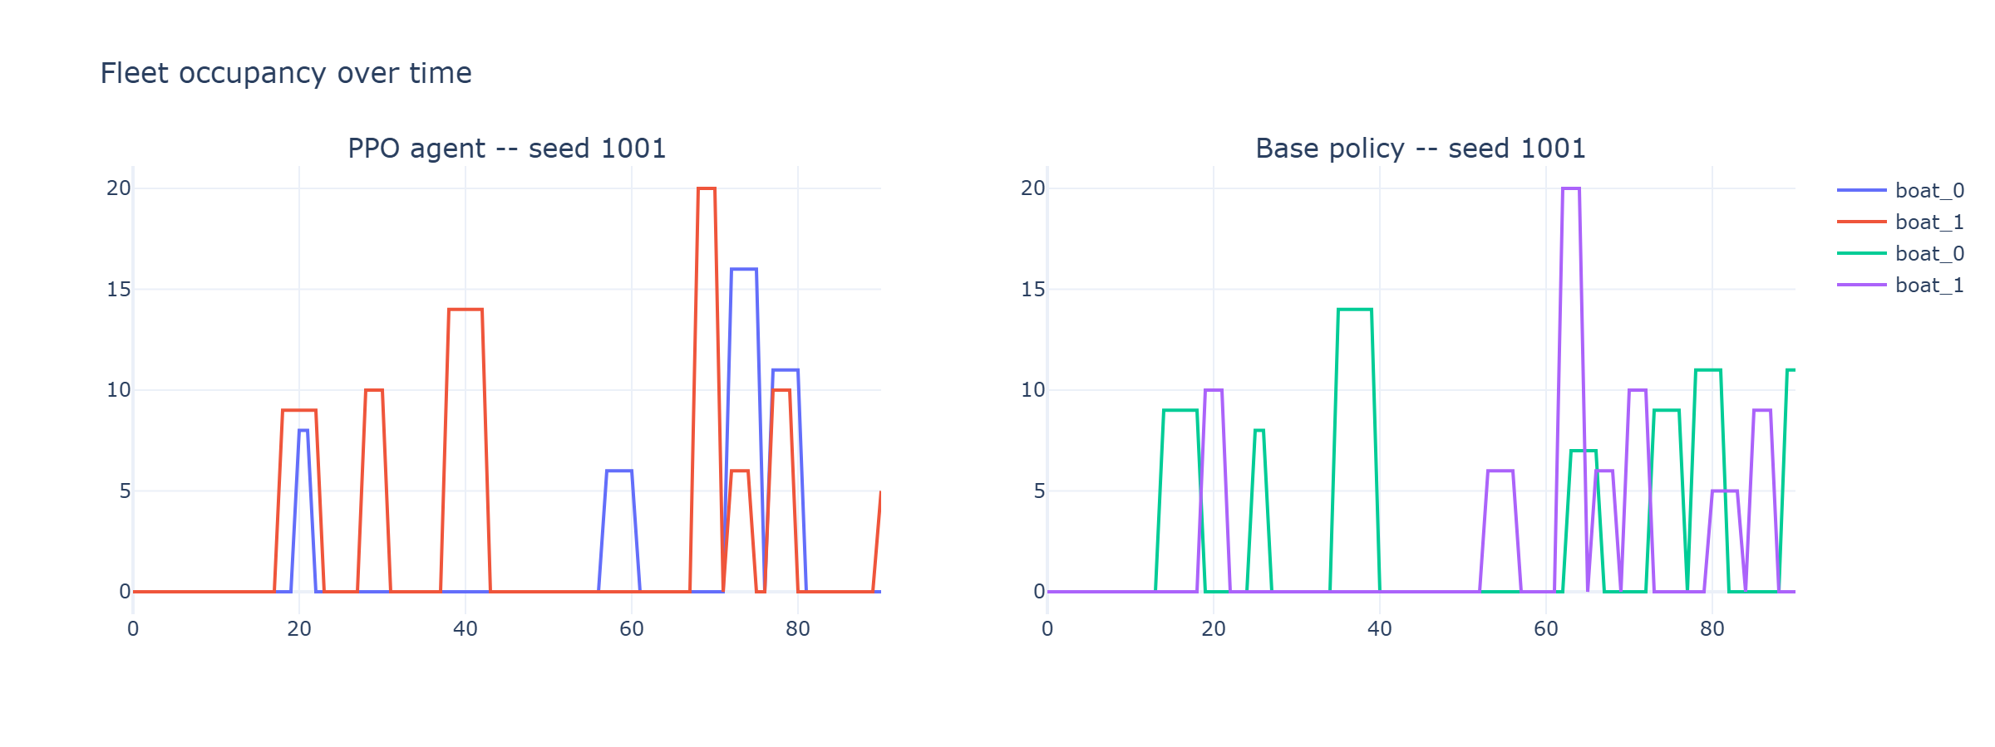
Comparison: detail on a single held-out seed
Waiting profile, agent vs baseline
Compliance per origin-destination pair
Fleet occupancy, agent vs baseline
19

Slide 20
A hyperparameter matters: update horizon
Same reward and training budget, only the PPO update horizon changes.
512 reaches parity with the baseline, 90 does not.
A reminder that early failures were configuration, not the approach itself.
20

Slide 21
Assumptions and limitations
Demand is synthetic. It is anchored in real population, jobs and the national travel survey, but not observed.
Boats make direct point-to-point trips. Multi-stop routes and mixed destinations are a later extension.
The catchment zones and the water-capture fraction are design choices, to be tested for sensitivity.
Results are a first end-to-end version on the morning instance, not the final tuned model.
The agent does not yet choose which passengers to pick up. A fixed rule does that for now.
21

Slide 22
Conclusion
A full pipeline is in place: navigable routing, data-anchored demand, an MDP simulator, a coordinated baseline and a learned PPO agent.
The reward is derived from the true objective through Little's law, not hand-tuned.
On held-out demand the agent reaches parity with a strong coordinated heuristic and improves the worst-case time.
Next: compare the reward variants under longer training, then scale from the morning to a full day and week.
The contribution is a learned, real-time, schedule-free policy, the dynamic operation the earlier static models did not address.
22

